Slide 1
Chapter 5
Drives of
Induction Machine

Slide 2
Chapter 5
Drives of Induction Machine
5.1 Mechanical Characteristics of IM
5.2 Starting of a Squirrel-Cage Motor
5.3 Starting of Wound Rotor Motor
5.4 Speed Adjustment of IM

Slide 3
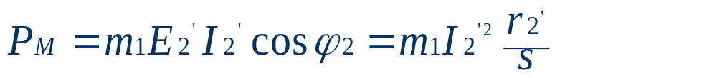
5.1 Mechanical Characteristics of IM
n=f (T); s=f (T)
5.1.1 Physical Expression of the Mechanical
Characteristic
As discussed in chapter 3, the electromagnetic power can be expressed as:

Slide 4
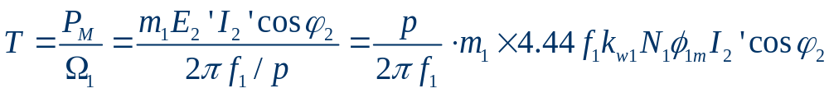
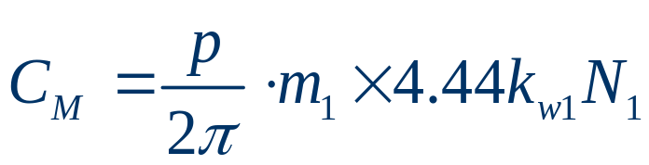
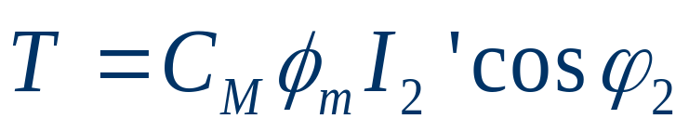
5.1 Mechanical Characteristics of IM
5.1.1 Physical Expression of the Mechanical Characteristic
From that, the electromagnetic torque is given by:
Assume constant
then the electromagnetic torque is:

Slide 5


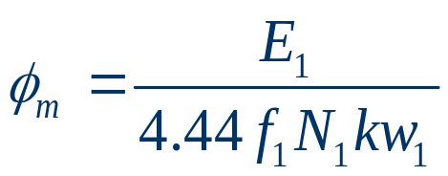


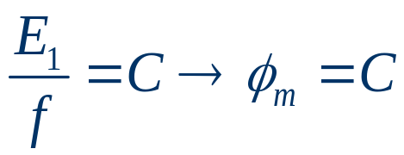
5.1.1 Physical Expression of the Mechanical Characteristic
The relation between flux and slip s
When omit ,
,
which means the flux will not vary with slip s.

Slide 6

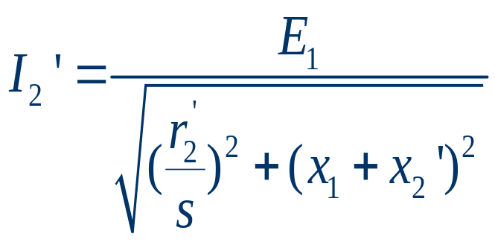
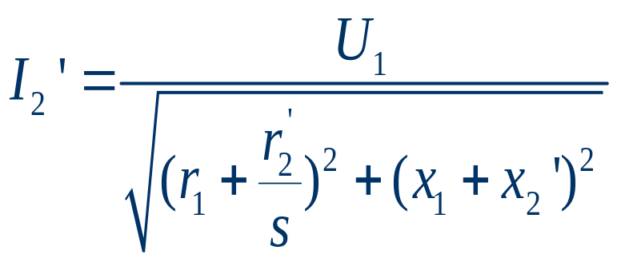
5.1.1 Physical Expression of the Mechanical Characteristic
The relation between rotor current and slip s
From simplified equivalent circuit we have:
And approximately:

Slide 7


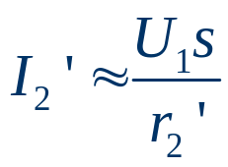



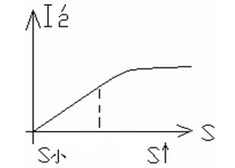
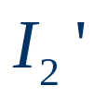
5.1.1 Physical Expression of the Mechanical Characteristic
At normal situation, when
is very small,
will be very
large compared with other parameters, so that
,
which is proportional to slip s. When
increases,
becomes dominant part of the parameters, rotor current
turns to be constant.
From the above analysis, the
curve of the referred rotor current
is as shown on the left .

Slide 8
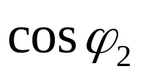
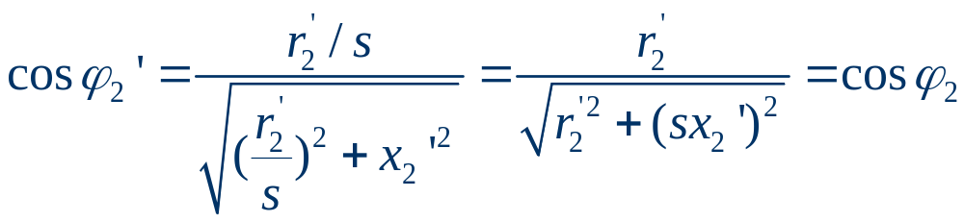



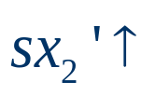
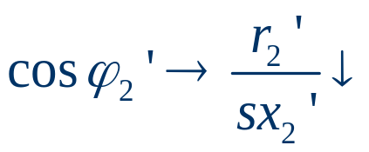

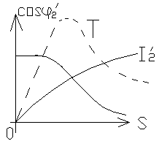

5.1.1 Physical Expression of the Mechanical Characteristic
The relation between and s
When slip s is very small, so
and
When
, and
From the above analysis, the
curve of the is as shown
on the left.

Slide 9

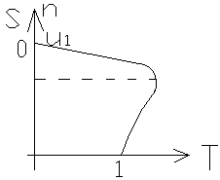
5.1.1 Physical Expression of the Mechanical Characteristic
Mechanical Characteristic
From above analysis, the curve of electromagnetic torque
is determined by the multiplication of rotor
current and power factor, so that the torque can be got as shown
below.

Slide 10
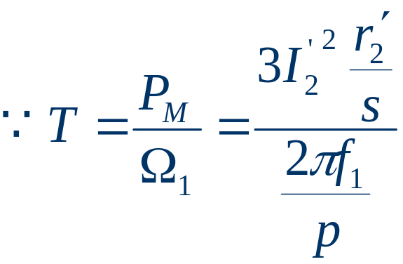
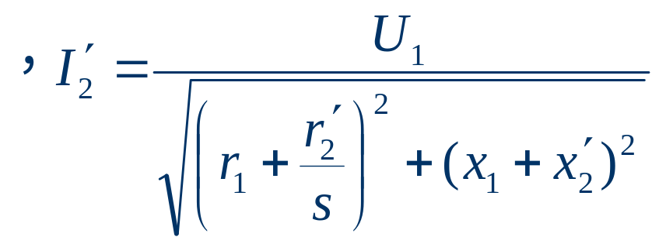
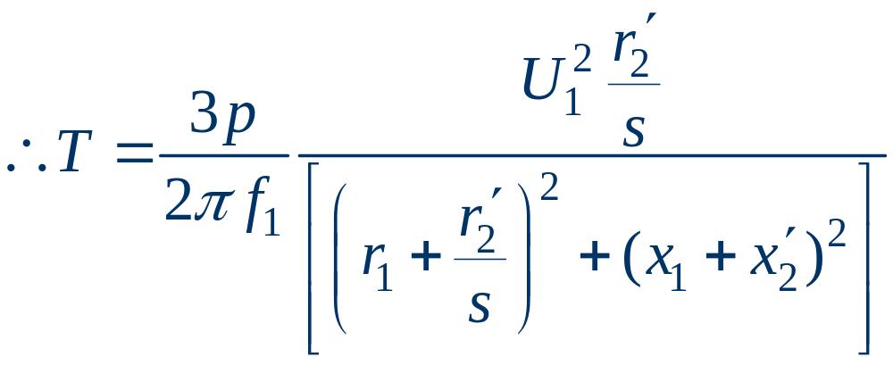
5.1 Mechanical Characteristics of IM0
5.1.2 Parameter Expression
The electromagnetic torque can be expressed by

Slide 11
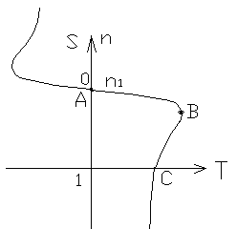
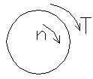
5.1.2 Parameter Expression
This is the parameter expression, in which the torque T is expressed as the function of slip s. By giving different values of s, the curve of the torque can be drawn as below in quadrant one, two and four.
1.Quadrant one
When 0<s<1 or 0<n<n1, and T>0
According to the assumption of the positive directions of torque and speed, the torque and speed are all positive, so that the machine is in motoring operation state.
T – n curve in different
quadrant

Slide 12
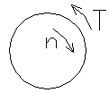
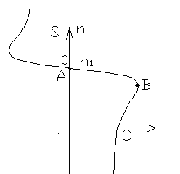
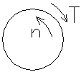
5.1.2 Parameter Expression
2.Quadrant Two
When s<0 or n>n1, and T<0
This is the generating operation state.
3.Quadrant Four
When s>1 or n<0, and T>0
T – n curve in different
quadrant
This is breaking operation state.

Slide 13
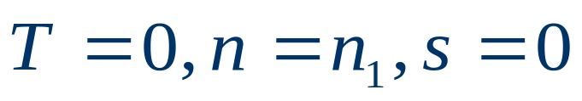
5.1.2 Parameter Expression
We can see the A.B.C points on the curve are important. If the points A.B and C are known, the shape of the T – n curve can be drawn roughly.
Point A
This is the synchronous speed point.
At which there is no relative motion between synchronous magnetic field speed and rotor rotating speed.
There is no power conversion from electrical energy to mechanical energy.
T – n curve in different
quadrant

Slide 14
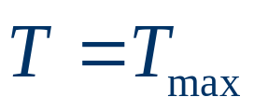

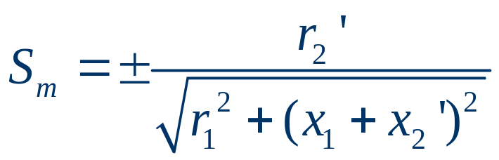


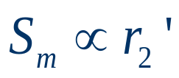
5.1.2 Parameter Expression
Point B
This is the point when maximum torque occurs. This point can be found by assuming , then:
It is seen that the critical slip is proportional to rotor resistance , i.e. .
T – n curve in different
quadrant

Slide 15
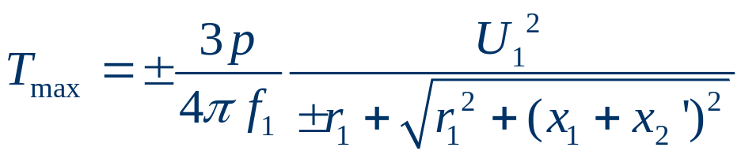
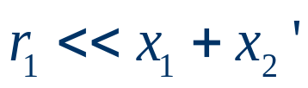
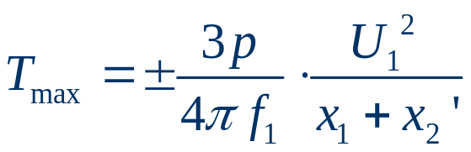
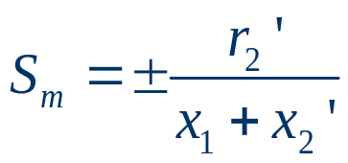





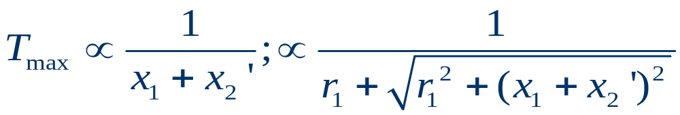
5.1.2 Parameter Expression
Substitute into T, then the maximum torque is:
If consider then
and
Summary :
(1) (2)
(3) has no relation with
(4)
(5)

Slide 16
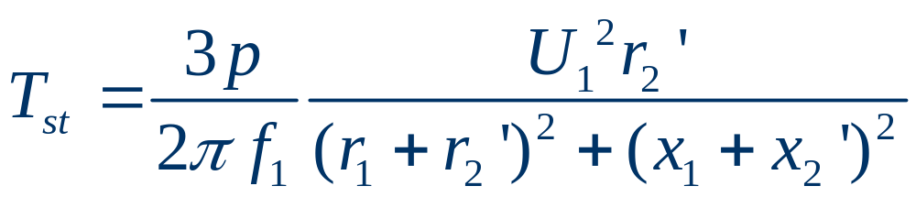


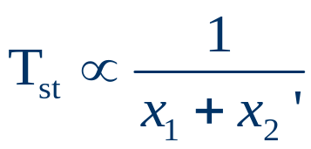
5.1.2 Parameter Expression
Point C
starting point , s=1,n=0,T=Tst
Summary :
(1)
(2) If
(3)
T – n curve in different
quadrant

Slide 17
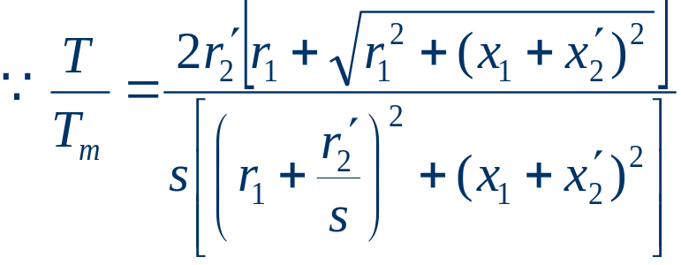
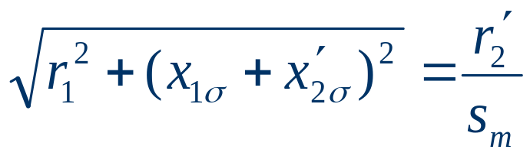
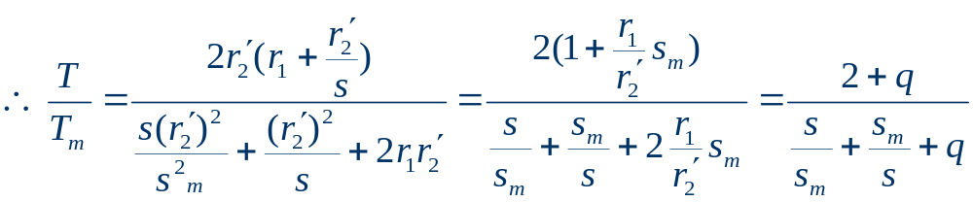
5.1 Mechanical Characteristics of IM
5.1.3 Practical Expression
The purpose of the Practical Expression is to get n -- T curve from name plate data.

Slide 18
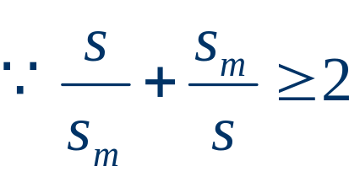
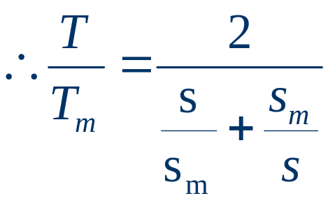
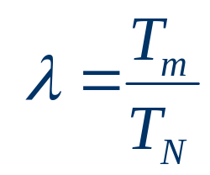
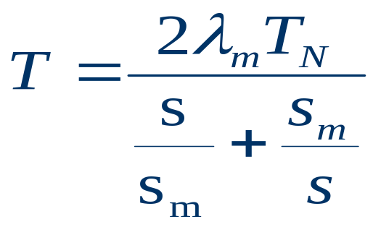
5.1.3 Practical Expression
, q<< 2
Introduce
then

Slide 19
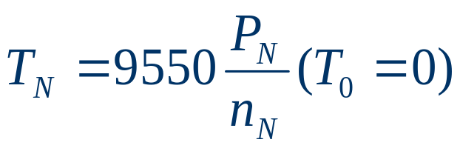
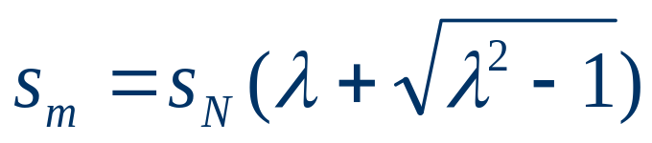
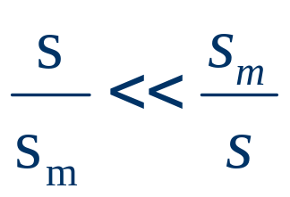
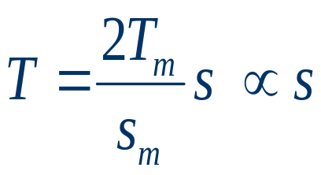
5.1.3 Practical Expression
We should sort out two things:
(1) Rated torque TN
(2)Critical slip Sm
Again, if consider then
Which is a straight line with s as variable. In many circumstances, considering the mechanical characteristic as a straight line will not cause large error.

Slide 20
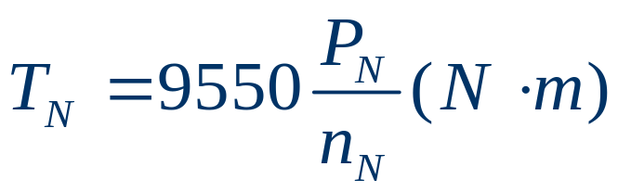
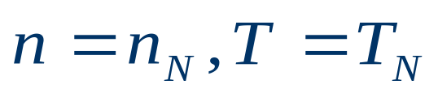
5.1 Mechanical Characteristics of IM
5.1.4 Connatural Mechanical Characteristic from Name Plate Data
So-called connatural mechanical characteristic is the T – n curve when keeping the original parameters of the IM and when the voltage and frequency are rated.
Any mechanical characteristic of induction machine can be approximately known by three points:
Rated operation point
, and

Slide 21

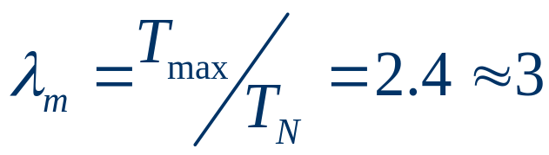



5.1.4 Connatural Mechanical Characteristic from Name Plate Data
Maximum torque point
Starting point

Slide 22


5.1.4 Connatural Mechanical Characteristic from Name Plate Data
Example 5-1:
4-pole IM,
Find out connatural mechanical characteristic.
Solution:

Slide 23


5.1 Mechanical Characteristics of IM
5.1.5 Steady-state Operation
When a disturbance force is applied on the ball, it will leave the top point because of the gravity, and will not return to the original top point when the disturbance force disappeared. We call this kind of system as unstable system.
When a disturbance force is applied on the ball and to force it leave the original point, then it will return to this point when the applied force disappears, which is called stable system.

Slide 24

5.1.5 Steady-state Operation
An induction motor driving a constant load shown on the left.
When motor work on point A: If TL is increased: T↓→n be↑→TL↓, then the system is steady.
When motor word on point B: If TL increased: T↓→n↓→TL↑, then the system is not steady.
Conclusion: If the motor work on the point of 0<S<Sm, the system is steady.
IM drives a constant load

Slide 25




5.1 Mechanical Characteristics of IM
5.1.6 Modified Mechanical Characteristics
So called modified is to see how the mechanical characteristics will be after changing some quantities
such as: .
1.T-n curve when
From equation
We know that

Slide 26






5.1.6 Modified Mechanical Characteristics
1.T-n curve when
So:
(1) not change
(2) has no relation with
(3)
T – n curve when reducing voltage

Slide 27





5.1.6 Modified Mechanical Characteristics
2. T-n curve when
From equation
We can conclude that when .

Slide 28




5.1.6 Modified Mechanical Characteristics
2. T-n curve when
T – n curve when increasing or

Slide 29




5.1.6 Modified Mechanical Characteristics
3. T-n curve when
From equation
We know that

Slide 30


5.1.6 Modified Mechanical Characteristics
3. T-n curve when
T-n curve when

Slide 31



5.1.6 Modified Mechanical Characteristics
From
We can conclude that: if we keep
then torque T will not change.
So that must be exist.

Slide 32




5.1.6 Modified Mechanical Characteristics
For the points with , we have
So: can ensure the torque is the maximum.
Maximum torque

Slide 33





5.1.6 Modified Mechanical Characteristics
When rotor winding is connected in Y,
The rotor resistance can be roughly calculated as:
Where rated rotor voltage (open circuit)
rated rotor current
and can be found in the Name Plate Data.

Slide 34





5.1.6 Modified Mechanical Characteristics
Example 5-2
An induction machine has the nameplate data as below:
a) In order to get maximum torque at starting, find out the resistance that should be connected to rotor circuit.
b) When load is , and if the speed is needed, what is the resistance that should be connected into rotor circuit?

Slide 35







5.1.6 Modified Mechanical Characteristics
Solution:
a) Rated slip
Rotor resistance
Critical slip:
From:

Slide 36







5.1.6 Modified Mechanical Characteristics
b) There are two ways to calculate the resistance.
Method 1.
From practical Expression:
We have
From

Slide 37







5.1.6 Modified Mechanical Characteristics
Method 2.
by simplified T-n curve
Suppose then:
and
It can be known that , when load torque is smaller than the rated torque, it is possible to consider the T – n curve as a straight line and it will not cause a lot error.

Slide 38



5.2 Starting of a Squirrel-Cage Motor
5.2.1 The Requirement for the starting of S-C motor
⑴ starting current can not be too lager
voltage drop ≤10﹪ UN
⑵ starting torque must be lager enough
So
The starting equipment should be cheap, reliable and easy to operate and maintenance.

Slide 39


5.2 Starting of a Squirrel-Cage Motor
5.2.2 Direct starting of Squirrel-cage Motor
Related data:
stall current
starting torque
Advantages: cheap, easy
Disadvantages: lager start current will cause larger
voltage drop.

Slide 40




5.2 Starting of a Squirrel-Cage Motor
5.2.3 Starting when Reducing Voltage
Reducing stator voltage can reduce the starting current.
When s=1, assume , then
Where:
Assume voltage reduction ratio.

Slide 41




5.2.3 Starting when Reducing Voltage
It can be seen that if want current reduce to we can have
But we have to note that the voltage reduction will reduce
torque.

Slide 42

5.2.3 Starting when Reducing Voltage
1. Stator has resistors series connected.
R
R
R
This is similar to that when reducing terminal voltage, the electromagnetic torque will reduce.
n
S_{m}
T
T_{S}
T_{max}

Slide 43






5.2.3 Starting when Reducing Voltage
2. Y - starting
When motor rated connection is , using Y start is corresponding to voltage reduction start.
a. Y connection when close and open
we call it Y connection. In this connection UYst is small .
b. connection when open, and close.

Slide 44



5.2.3 Starting when Reducing Voltage
2. Y - starting
Normally used for the motor less than
30kW and light load.

Slide 45


5.2.3 Starting when Reducing Voltage
3. Variac start
Auto-transformer starting
Auto-transformer starting

Slide 46

5.2 Starting of a Squirrel-Cage Motor
5.2.4 Squirrel-cage Motor with high starting torque
1. Deep slot rotor motor
If the current is direct current, the current density will be distributed evenly. But for ac current, it is different.

Slide 47


5.2.4 Squirrel-cage Motor with high starting torque
1. Deep slot rotor motor
(1) When starting:
At start, the rotor frequency is high, and rotor inductance is high .
The current at bottom will meet higher inductance, which will force the current tend to flow at the top. This corresponds the area of the inductor is reduced.
Consequently, the resistance of the rotor winding is increased, which will increase starting torque.
Deep slot rotor motor

Slide 48



5.2.4 Squirrel-cage Motor with high starting torque
1. Deep slot rotor motor
(2) When speed n is high
With the increase of speed n, the rotor frequency is reduced, and rotor inductance is not so sensitive with frequency, then the rotor current is more even, which corresponds the rotor resistance smaller.
The T – n curve of deep
slot rotor motor

Slide 49


5.2.4 Squirrel-cage Motor with high starting torque
2. Dual cage motor
The upper cage with high resistance and low inductance is used for starting.
The lower cage with high inductance and low resistance is used for normal operation.
By this way, the T – n curve can be modified to have higher starting torque and higher efficiency at normal operation.

Slide 50





5.3 Starting of wound rotor motor
5.3.1 Rotor has resistors connected
Motor rotor is connected with resistors is shown below:
(1) when contacts 1.2.3. KM are open
After the power is switched on, the system will speed up from point a to b. is the starting torque, which is about 0.9 normally, and (can be 1.1 ).

Slide 51



5.3.1 Rotor has resistors connected
(2) Turn on 1KM at b point and short circuited
Then the speed will go up from c to d.
(3) Turn on 2KM at d point and short circuited
Then the speed goes up from e to f.
(4) Turn on 3KM at f point cut off
Then the speed will be increased from g to h, and then j, reaching the stable operation point.

Slide 52







5.3.1 Rotor has resistors connected
For
If T is known, S can be found, i.e.
where:
--- torque function
when ,
when ,

Slide 53









5.3.1 Rotor has resistors connected
At torque:
At torque:
So
From the diagram,

Slide 54








5.3.1 Rotor has resistors connected
Assume
then
If the steps is m, then
From points a and g,
From Curve 4,
So

Slide 55





5.3.1 Rotor has resistors connected
Summary :
1. Determine then calculate .
2. From , calculate m, .
Then round m to closed integer m’.
3. Calculate q from .
4. At last, calculate resistance with q.

Slide 56


5.3 Starting of wound rotor motor
5.3.2 Rotor has Frequency-sensitive Resistor connected
Frequency-sensitive resistor--- a resistor can reduce with rotor frequency decreasing during start up.
The frequency-sensitive resistor is made of thick steel boards as shown on left .

Slide 57





5.3.2 Rotor has Frequency-sensitive Resistor connected
---- an inductance
---- an imagined resistance, which consumes eddy-current power as the active power.
The equivalent circuit of a frequency-sensitive resistor
At the beginning of start, the frequency is high, and the eddy-current loss is high, which is proportional to the square of the frequency, so the resistance is high. At the same time, the inductance is designed to saturated, so the value of is small.

Slide 58

5.3.2 Rotor has Frequency-sensitive Resistor connected
When the starting is nearly finished, rotor frequency is very small, which makes eddy current loss reduced, therefore, the and are both reduced. Hence the T – n curve is shown as below.
The T – n curve of a frequency-sensitive resistor

Slide 59



5.4 Speed Adjustment of IM
5.4.1 Speed Adjustment Summery
The speed of an induction machine can be expressed as:
It can be known that the speed is related to slip s, number of
pole pairs and frequency .
In above sections, we have discussed a lot to change s by
adjusting terminal voltages, and motor parameters, and at the
following section, the change of number of pole pairs and
frequency is discussed.

Slide 60







5.4 Speed Adjustment of IM
5.4.2 Change p, the number of pole pair
N
S
N
S
N
S

Slide 61

5.4.2 Change p, the number of pole pair
So the T – n curve will be shown as below:
T – n curve when change number of pole pairs

Slide 62


5.4 Speed Adjustment of IM
5.4.3 Speed Adjustment With Voltage Reduction
Voltage reduction for
high slip motor
Voltage reduction for
general motor
It can be seen that it is suitable for high slip motor.
For high slip motor, when the slip is increased, the slip power will be increased as well, which will be lost in rotor circuit.

Slide 63

5.4.3 Speed Adjustment With Voltage Reduction
If the change of the number of pole pairs is used together with the voltage reduction, the T – n curve is shown below and the efficiency will be much higher.
Speed adjustment with voltage reduction

Slide 64
5.4 Speed Adjustment of IM
5.4.4 Wound Rotor
The T – n curve of the rotor with extra resistors connected can be referenced to the figure shown below.
Rotor has resistors connected

Slide 65


5.4 Speed Adjustment of IM
5.4.5 Cascade Speed Control
Series connected potential in rotor circuit as shown below.
Series connected potential in rotor circuit
the rotor current is

Slide 66





5.4.5 Cascade Speed Control
If and are un-change, and consider then
should be about a constant. i.e. .
If the additional potential is negative, then the slip s will increase, and resulting that the speed n will be reduced.
Otherwise if the additional potential is positive, the slip s will be decreased, and resulting that the speed n will be increased.

Slide 67


5.4 Speed Adjustment of IM
5.4.6 Frequency Control
We may use the way shown on right. We may use transducer to change frequency.
From the equation
Then flux is :

Slide 68

5.4.6 Frequency Control
To keep flux at constant to achieve high efficiency.
Coordinated control

Slide 69

5.4.6 Frequency Control
With the coordinated control, the performance of variable-frequency speed adjustment is shown below.
n
f₁> f₂> f₃ >f₄
Advantage :
1.Large marine-propulsion units supplied from variable-speed turbine generators.
2.Offer an economic solution to a speed-control problem.
f₁
f₂
f₃
f₄
0
T_{L}
T
Coordinated control

